Slide 1
Phase II design & analysis
Group 3: Haoxi, Wenxiao, Bonnya, Ziqi, Zewei

Slide 2
Trail-design part

Slide 3
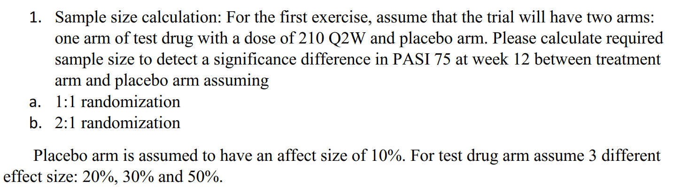
Question I

Slide 4






$$\text{Question} \text{I}\text{−}\text{a}\text{−}\text{how}\text{?}$$
We assume two group follow normal distribution
Then
$$\left.x_{c1},x_{c2},…,x_{cn}\sim N(μ_{c},σ_{c}^{2}\right)$$
$$\frac{\left.D−(μ_{t}−μ_{c}\right)}{\sqrt{\frac{σ_{t}^{2}+σ_{c}^{2}}{n}}}\sim N(0,1)$$
$$\left.x_{t1},x_{t2},…,x_{tn}\sim N(μ_{t},σ_{t}^{2}\right)$$
Then we have
Under null hypothesis we have
$${\overline{x}}_{c}\sim N(μ_{c},\frac{σ_{c}^{2}}{n})$$
$$z_{0}=\frac{D}{\sqrt{\frac{σ_{t}^{2}+σ_{c}^{2}}{n}}}\sim N(0,1)$$
Hypotheses
$$H_{0}: μ_{t}=μ_{c}$$
$$H_{a}:μ_{t}≠μ_{c}$$
Under alternative hypothesis, recall
$$\frac{\left.D−(μ_{t}−μ_{c}\right)}{\sqrt{\frac{σ_{t}^{2}+σ_{c}^{2}}{n}}}\sim N(0,1)$$
Denote D as
$$D={\overline{x}}_{t}−{\overline{x}}_{c}$$
Then we could know the D follow normal distribution
So we could derive
$$D\sim N(μ_{t}−μ_{c},\frac{σ_{t}^{2}+σ_{c}^{2}}{n})$$
$$z_{0}=\frac{D}{\sqrt{\frac{σ_{t}^{2}+σ_{c}^{2}}{n}}}\sim N\left(\frac{\left(μ_{t}−μ_{c}\right)}{\sqrt{\frac{σ_{t}^{2}+σ_{c}^{2}}{n}}},1\right)$$

Slide 5
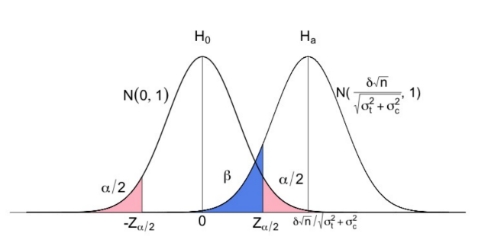
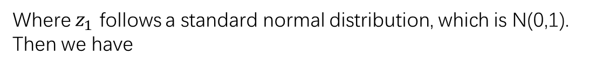





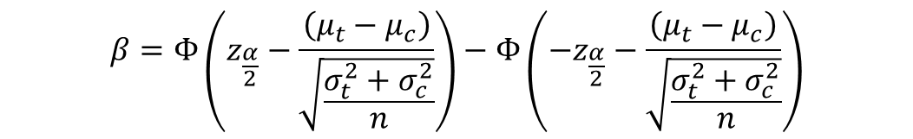
Question I-a-how?
Recall that alpha is type I error which is
Then we calculate the failing to reject range.
$$\left.α=p(rejectH_{0}|H_{0} \right)$$
We could derive
And beta is type II error which is
$$−z_{\frac{α}{2}}−\frac{\left(μ_{t}−μ_{c}\right)}{\sqrt{\frac{σ_{t}^{2}+σ_{c}^{2}}{n}}}≤z_{1}≤z_{\frac{α}{2}}−\frac{\left(μ_{t}−μ_{c}\right)}{\sqrt{\frac{σ_{t}^{2}+σ_{c}^{2}}{n}}}$$
$$\left.β=p(fail to reject H_{0} |H_{a}\right)$$
So we have
$$−z_{α/2}≤z_{0}≤z_{α/2}$$
Where $z_{1}$ follows a standard normal distribution, which is N(0,1).
Then we have
Where $z_{0}$ under alternative hypothesis.
$$β=Φ\left(z_{\frac{α}{2}}−\frac{\left(μ_{t}−μ_{c}\right)}{\sqrt{\frac{σ_{t}^{2}+σ_{c}^{2}}{n}}}\right)−Φ\left(−z_{\frac{α}{2}}−\frac{\left(μ_{t}−μ_{c}\right)}{\sqrt{\frac{σ_{t}^{2}+σ_{c}^{2}}{n}}}\right)$$
We could notice that
$$Φ\left(−z_{\frac{α}{2}}−\frac{\left(μ_{t}−μ_{c}\right)}{\sqrt{\frac{σ_{t}^{2}+σ_{c}^{2}}{n}}}\right)≈0$$

Slide 6
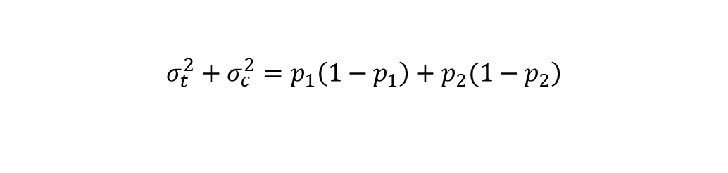



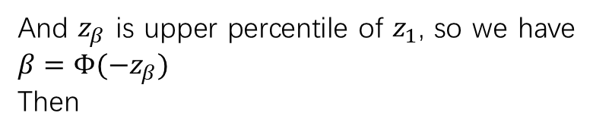

Question I-a-how?
So the $β$ is roughly equal to
According to the information we get from question, we have
$$β≈Φ\left(z_{\frac{α}{2}}−\frac{\left(μ_{t}−μ_{c}\right)}{\sqrt{\frac{σ_{t}^{2}+σ_{c}^{2}}{n}}}\right)$$
$$μ_{t}−μ_{c}=p_{1}−p_{2}$$
And we could regard the treatment effect as a Bernoulli distribution, whose variance is p(1-p), so we could get
And $z_{β}$ is upper percentile of $z_{1}$, so we have $β=Φ(−z_{β})$
Then
$$−z_{β}=z_{\frac{α}{2}}−\frac{\left(μ_{t}−μ_{c}\right)}{\sqrt{\frac{σ_{t}^{2}+σ_{c}^{2}}{n}}}$$
$$\left.σ_{t}^{2}+σ_{c}^{2}=p_{1}\left(1−p_{1}\right)+p_{2}(1−p_{2}\right)$$
For unbalanced data:
Finally, we could derive the sample size formula:
$$−z_{β}=z_{\frac{α}{2}}−\frac{\left(μ_{t}−μ_{c}\right)}{\sqrt{\frac{σ_{t}^{2}}{n_{1}}+\frac{σ_{c}^{2}}{n_{2}}}}$$
$$n=\frac{\left.{\left(z_{α/2}+z_{β}\right)}^{2}∗(σ_{t}^{2}+σ_{c}^{2}\right)}{{\left(μ_{t}−μ_{c}\right)}^{2}}$$

Slide 7


Question I-a
We already know for balanced group, sample size is
$$n=\frac{\left.{\left(z_{α/2}+z_{β}\right)}^{2}∗(p_{1}\left(1−p_{1}\right)+p_{2}(1−p_{2})\right)}{{\left(p_{1}−p_{2}\right)}^{2}}$$
Where α is the type I error, β is the type II error, and p_1 is the effect size of placebo, p_2 is the effect size of drug.
We pre-specify
$$α=0.05, and β=0.1$$
Then we could get
$$z_{α/2}=1.96, z_{β}=1.28$$
And we have
$$p_{1}=0.1, p_{2}=0.2,0.3,0.5 respectively$$
Then we could calculate n=262.44, 78.732, 22.3074 respectively. Therefore, the sample size is 263, 79 and 23 when the drug’s effect size is 20%, 30% and 50%.

Slide 8
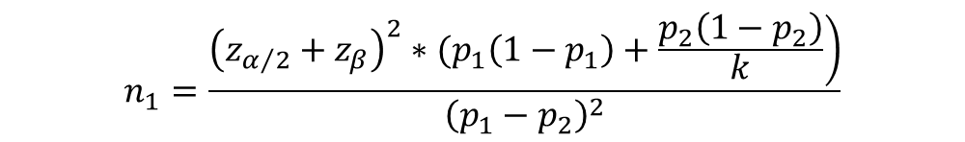


Question I-b
We have the sample size formula:
$$n_{1}=\frac{\left.{\left(z_{α/2}+z_{β}\right)}^{2}∗(p_{1}\left(1−p_{1}\right)+\frac{p_{2}\left(1−p_{2}\right)}{k}\right)}{{\left(p_{1}−p_{2}\right)}^{2}}$$
$$n_{2}=k∗n_{1}$$
We pre-specify
$$α=0.05, and β=0.1$$
Then we could get
$$z_{α/2}=1.96, z_{β}=1.28$$
And according to the question, we have
$$k=\frac{n_{2}}{n_{1}}=2, p_{1}=0.1, p_{2}=0.2,0.3,0.5 respectively$$
the sample size is (179,358), (52,104) and (15,30) when the drug’s effect size is 20%, 30% and 50%.

Slide 9
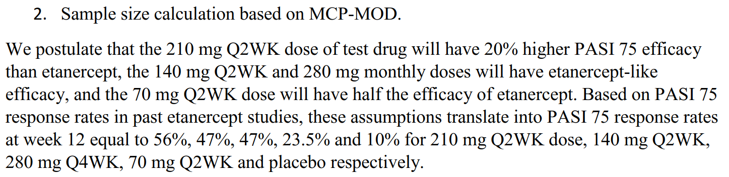
Question II

Slide 10
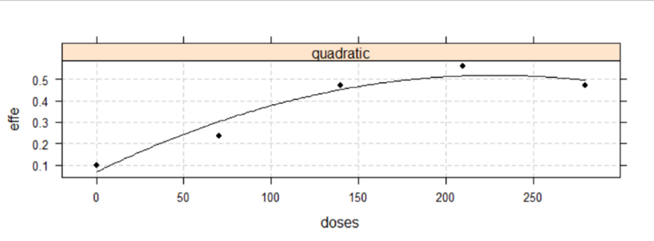
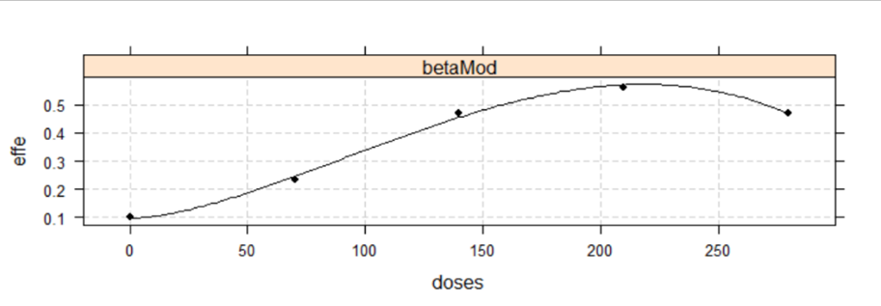
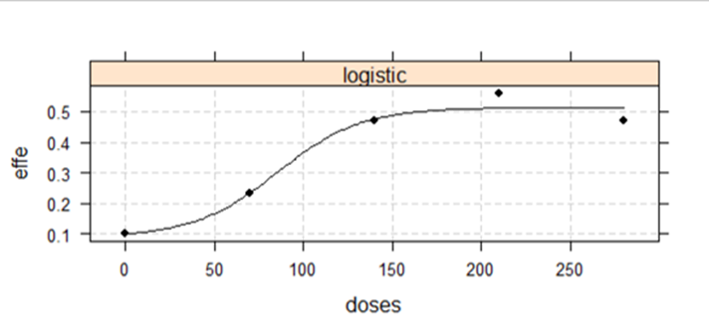
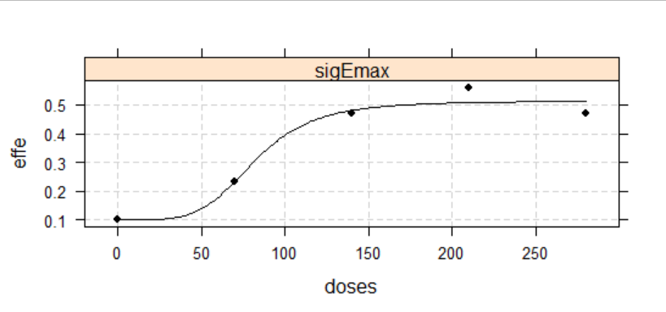
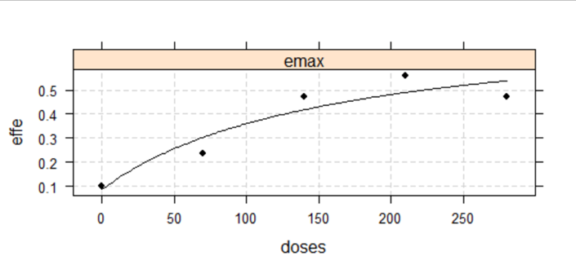
Fit model
quadratic
betaMod
logistic
sigEmax
emax

Slide 11
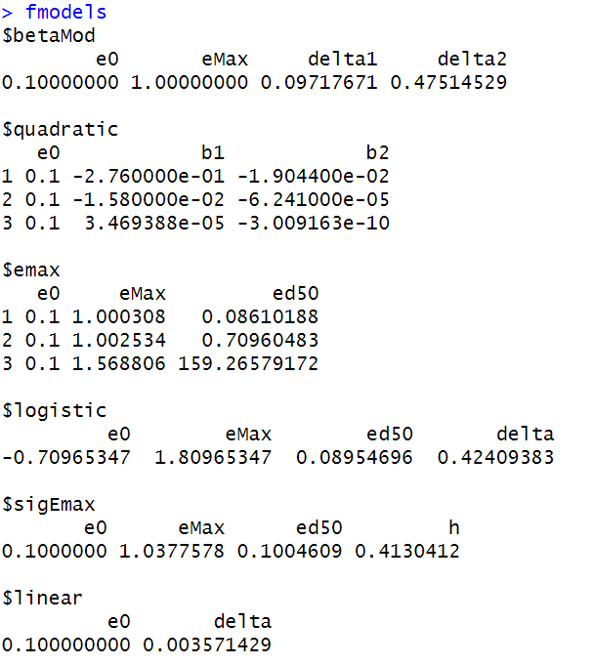





Construct candidate models set
Quadratic:
$$f\left(d,θ\right)=E_{0}+β_{1}d+β_{2}d^{2} β_{2}<0$$
$betaMod$:
$$f\left(d,θ\right)=E_{0}+E_{max}B\left(δ_{1},δ_{2}\right){\left(\frac{d}{D}\right)}^{δ_{1}}{\left(1−\frac{d}{D}\right)}^{δ_{1}}$$
$$emax:$$
$$f\left(d,θ\right)=E_{0}+E_{max}d/({ED}_{50}+d)$$
$$logistic:$$
$$f\left(d,θ\right)=E_{0}+E_{max}/\{1+exp[({ED}_{50}−d)/δ]\}$$
$$sigEmax:$$
$$f\left(d,θ\right)=E_{0}+E_{max}d^{h}/({{ED}_{50}}^{h}+d^{h})$$
$$linear:$$
$$f\left(d,θ\right)=E_{0}+δd$$

Slide 12
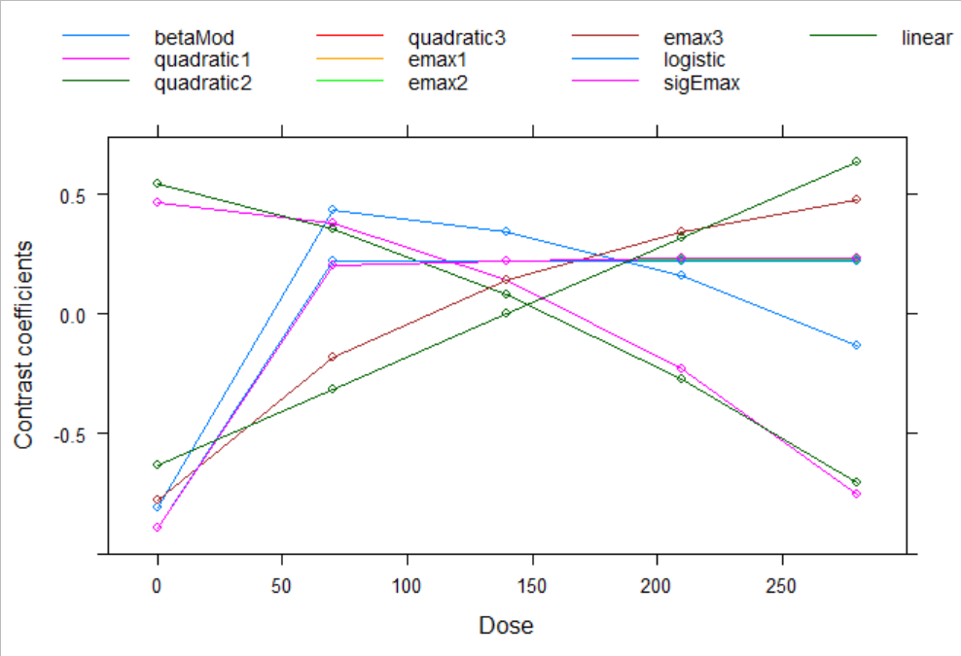
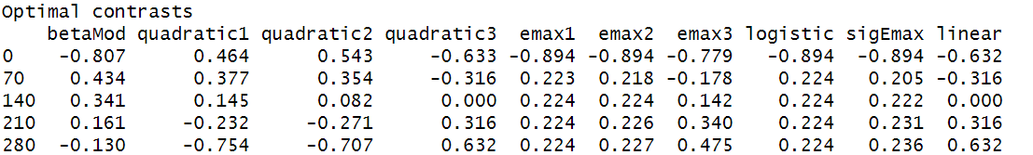
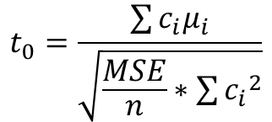

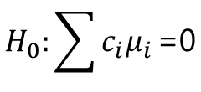
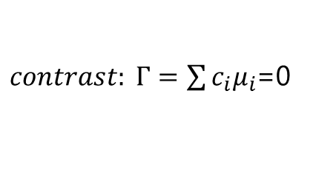
Optimal contrast
$contrast: Γ=\sum{c_{i}μ_{i}}$=0
hypothesis
$$H_{0}:\sum{c_{i}μ_{i}}\text{=0}$$
$$H_{1}:\sum{c_{i}μ_{i}}≠\text{0}$$
statistic
$$t_{0}=\frac{\sum{c_{i}μ_{i}}}{\sqrt{\frac{MSE}{n}∗\sum{{c_{i}}^{2}}}}$$

Slide 13
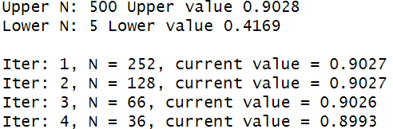
Sample calculation
result: to satisfy 0.9 power at 0.05 level, our minimum sample size is 36

Slide 14
Data analysis part

Slide 15
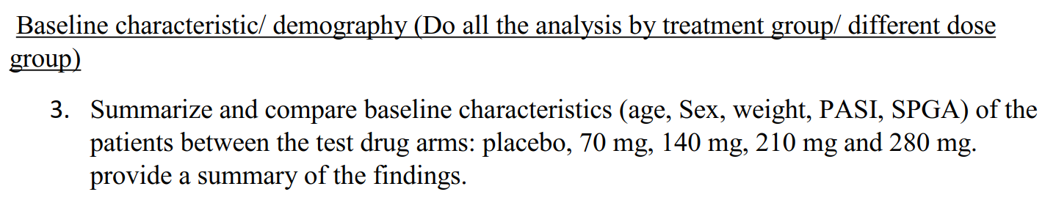
Question III

Slide 16
Question III-summary
Table 1: Baseline Characteristics of the Patients
Characteristic | Test drug 70mg | Test drug 140mg | Test drug 210mg | Test drug 280mg | Placebo
 | N=39 | N=39 | N=40 | N=42 | N=38
Age
Mean--yr, (SD) | 42.1 (11.45) | 43.97 | 42.1 | 42.29 | 41.84 (14.39)
20 <= AGE < 40--no. (%) | 19 (48.7) | 16 (41) | 19 (47.5) | 20 (47.6) | 19 (50)
40 <= AGE < 60--no. (%) | 19 (48.7) | 17 (43.6) | 18 (4.5) | 18 (42.9) | 14 (36.8)
60 <= AGE < 80--no. (%) | 1 (2.4) | 6 (15.4) | 3 (7.5) | 4 (9.5) | 5 (13.2)
Sex
Female--no. (%) | 17 (43.6) | 11 (28.2) | 15 (37.5) | 12 (28.6) | 16 (42.1)
Male--no. (%) | 22 (56.4) | 28 (71.8) | 25 (62.5) | 30 (71.4) | 22 (57.9)
Weight
Mean--kg, (SD) | 88.82 (21.96) | 92.44 (23.88) | 100.42 (20.2) | 91.52 (22.98) | 86.9 (20.61)
PASI
Mean (SD) | 18.82 (5.68) | 19.7 (6.7) | 20.6 (7.39) | 17.93 (5.46) | 18.89 (5.88)
sPGA
sPGA = 2--no. (%) | 15 (38.5) | 10 (25.6) | 10 (25) | 15 (35.7) | 8 (21.1)
sPGA = 3--no. (%) | 9 (23.1) | 13 (33.4) | 11 (27.5) | 11 (26.2) | 20 (52.6)
sPGA = 4--no. (%) | 11 (28.2) | 10 (25.6) | 8 (20) | 12 (28.6) | 4 (10.5)
sPGA = 5--no. (%) | 4 (10.2) | 6 (15.4) | 11 (27.5) | 4 (9.5) | 6 (15.8)

Slide 17
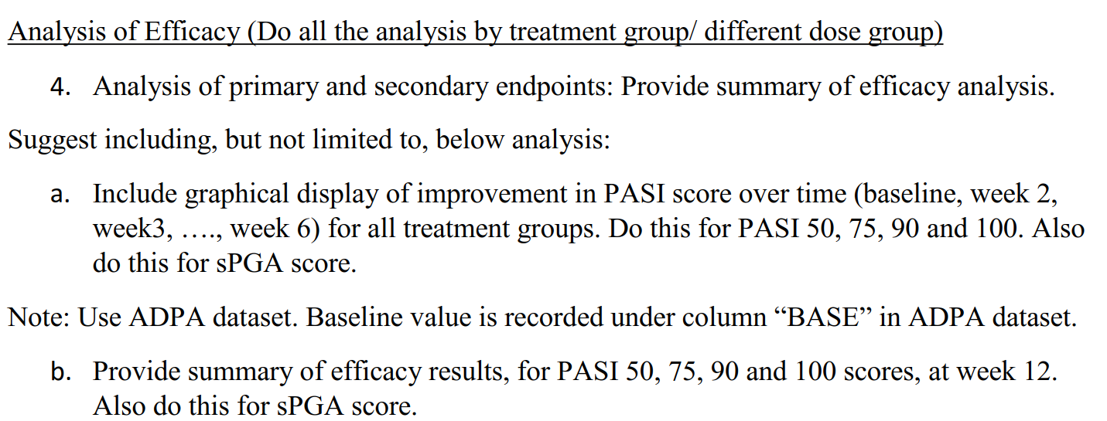
Question IV

Slide 18
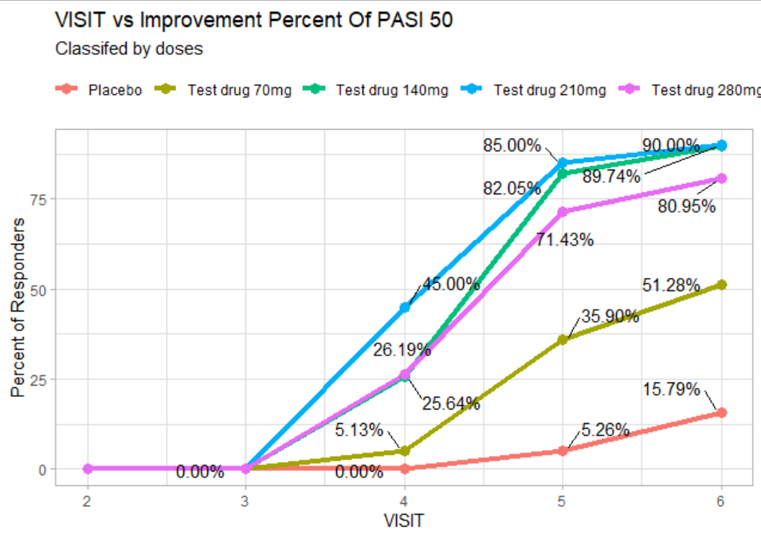
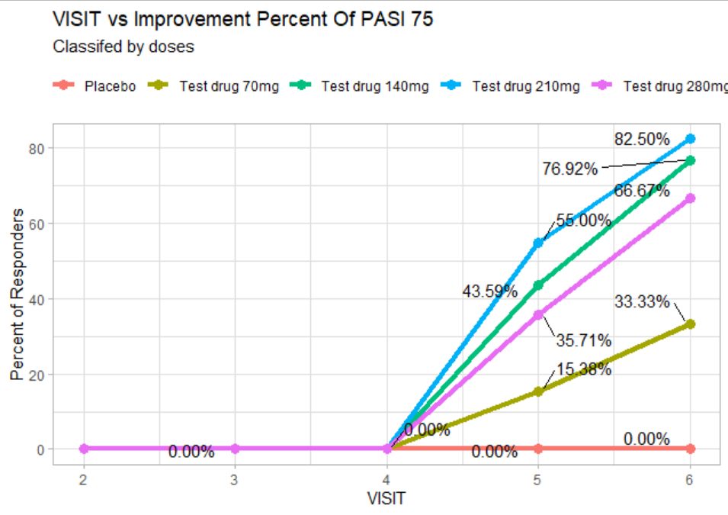
Question IV-a

Slide 19
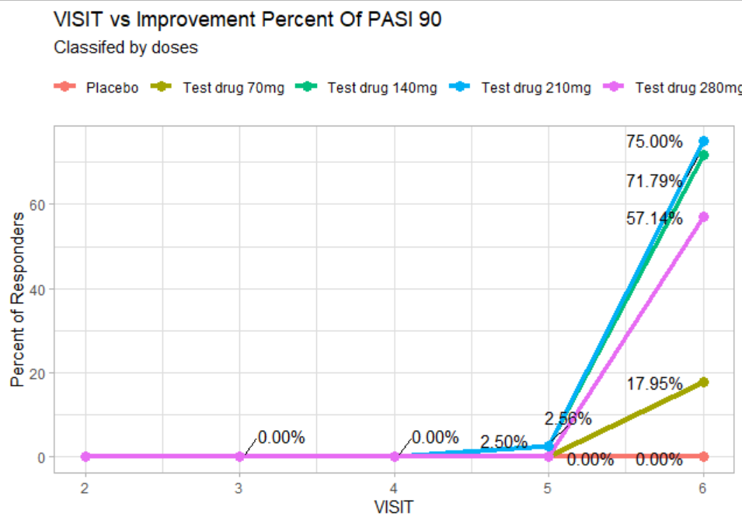
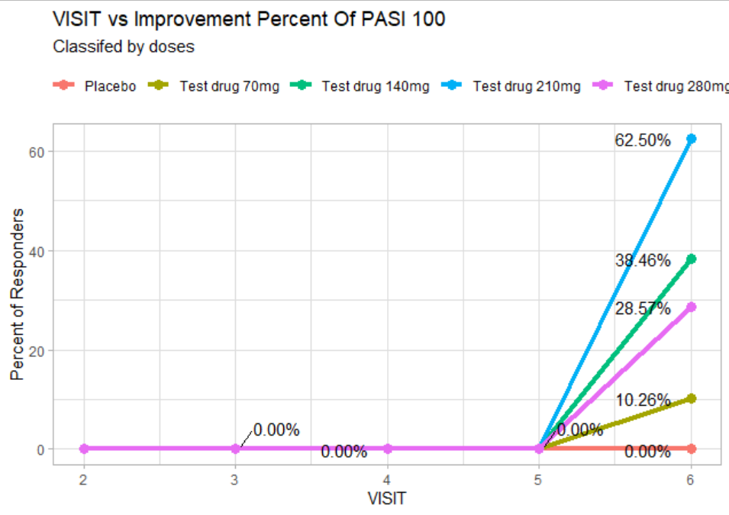
Question IV-a

Slide 20
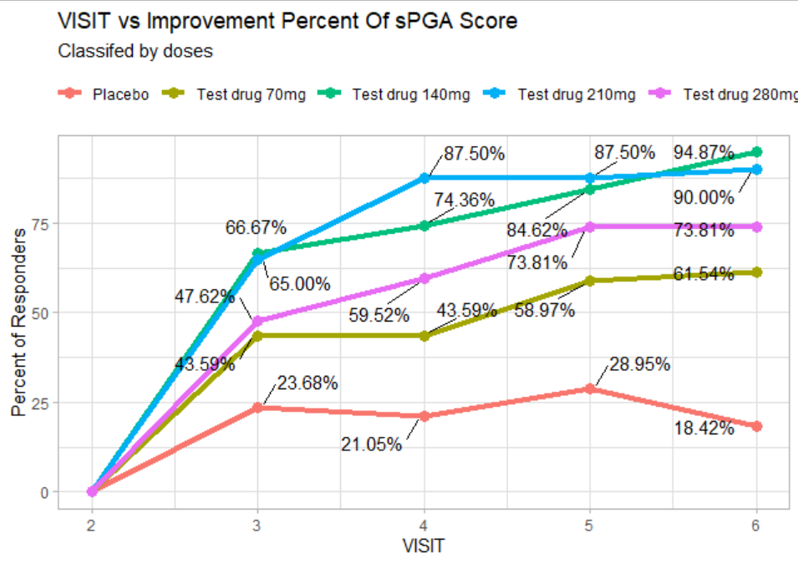
Question IV-a

Slide 21
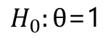
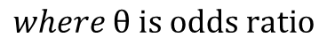
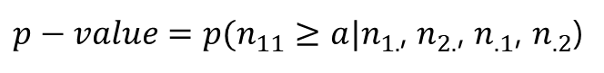
Question IV-b-fisher exact test
 | PASI50=1 | PASI50=0 | total
drug | a | b | a+b
placebo | c | d | c+d
total | a+c | b+d | a+b+c+d
hypotheses
$$H_{0}:θ\text{=}\text{1}$$
$$H_{1}:θ>1$$
$$where θ is odds ratio$$
$p−value=p(n_{11}≥a|n_{1.}$, $n_{2.}$, $n_{.1}$, $n_{.2}$)

Slide 22
Question IV-b-summary
 |  | Placebo (N=38) | Test drug 70mg (N=39) | Test drug 140mg (N=39) | Test drug 210mg (N=40) | Test drug 280mg (N=42)
PASI50 | no. | 6 | 20 | 35 | 36 | 34
 | %(95%CI) | 16(7-31) | 51(36-66) | 90(76-96) | 90(76-97) | 81(66-90)
 | P-value vs placebo |  | <0.001 | <0.001 | <0.001 | <0.001
PASI75 | no. | 0 | 13 | 30 | 33 | 28
 | %(95%CI) | 0(0-11) | 33(21-49) | 77(61-87) | 83(68-91) | 67(51-79)
 | P-value vs placebo |  | <0.001 | <0.001 | <0.001 | <0.001
PASI90 | no. | 0 | 7 | 28 | 30 | 24
 | %(95%CI) | 0(0-11) | 18(9-33) | 72(56-83) | 75(60-86) | 57(42-71)
 | P-value vs placebo |  | 0.006396 | <0.001 | <0.001 | <0.001
PASI100 | no. | 0 | 4 | 15 | 25 | 12
 | %(95%CI) | 0(0-11) | 10(4-24) | 38(25-54) | 63(47-76) | 29(17-44)
 | P-value vs placebo |  | 0.06078 | <0.001 | <0.001 | <0.001
sPGA score of 0 or 1 | no. | 1 | 10 | 33 | 32 | 29
 | %(95%CI) | 3(0-15) | 26(15-41) | 85(70-93) | 80(65-90) | 69(54,81)
 | P-value vs placebo |  | 0.003866 | <0.001 | <0.001 | <0.001
*95%CI calculated by Modified Wald Method
*P-value is calculated by Fisher Exact Test while alternative hypothesis is odds ratio is greater 1

Slide 23
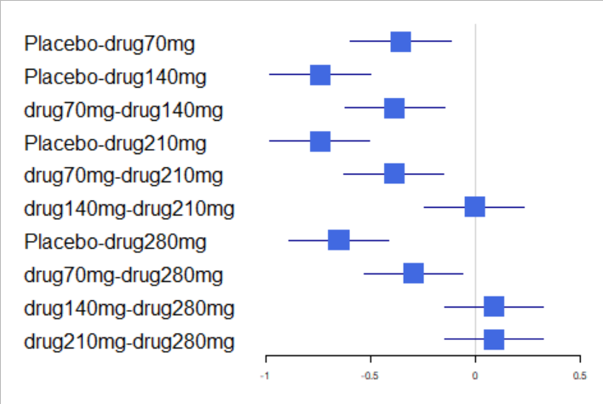
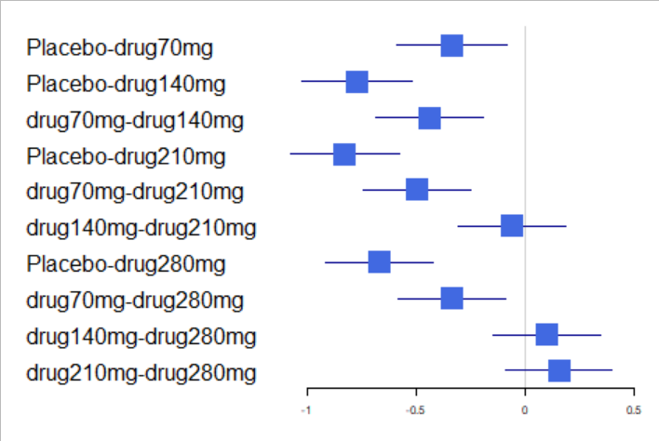
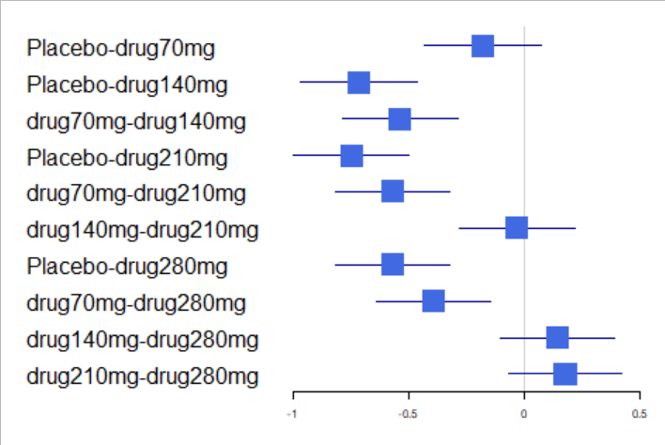
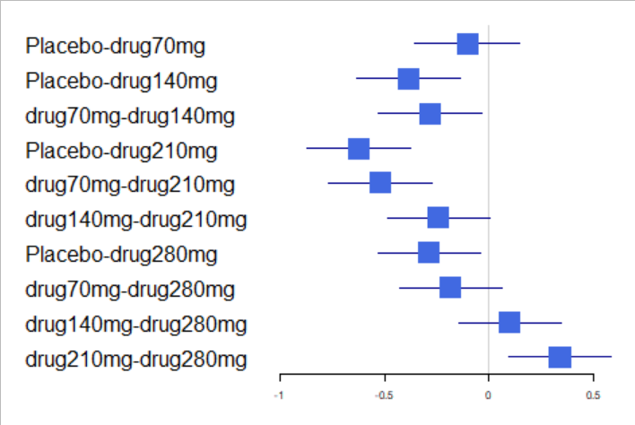
Question IV-b-pairwise comparison
For PASI 50:
For PASI 75:
For PASI 90:
For PASI 100:

Slide 24
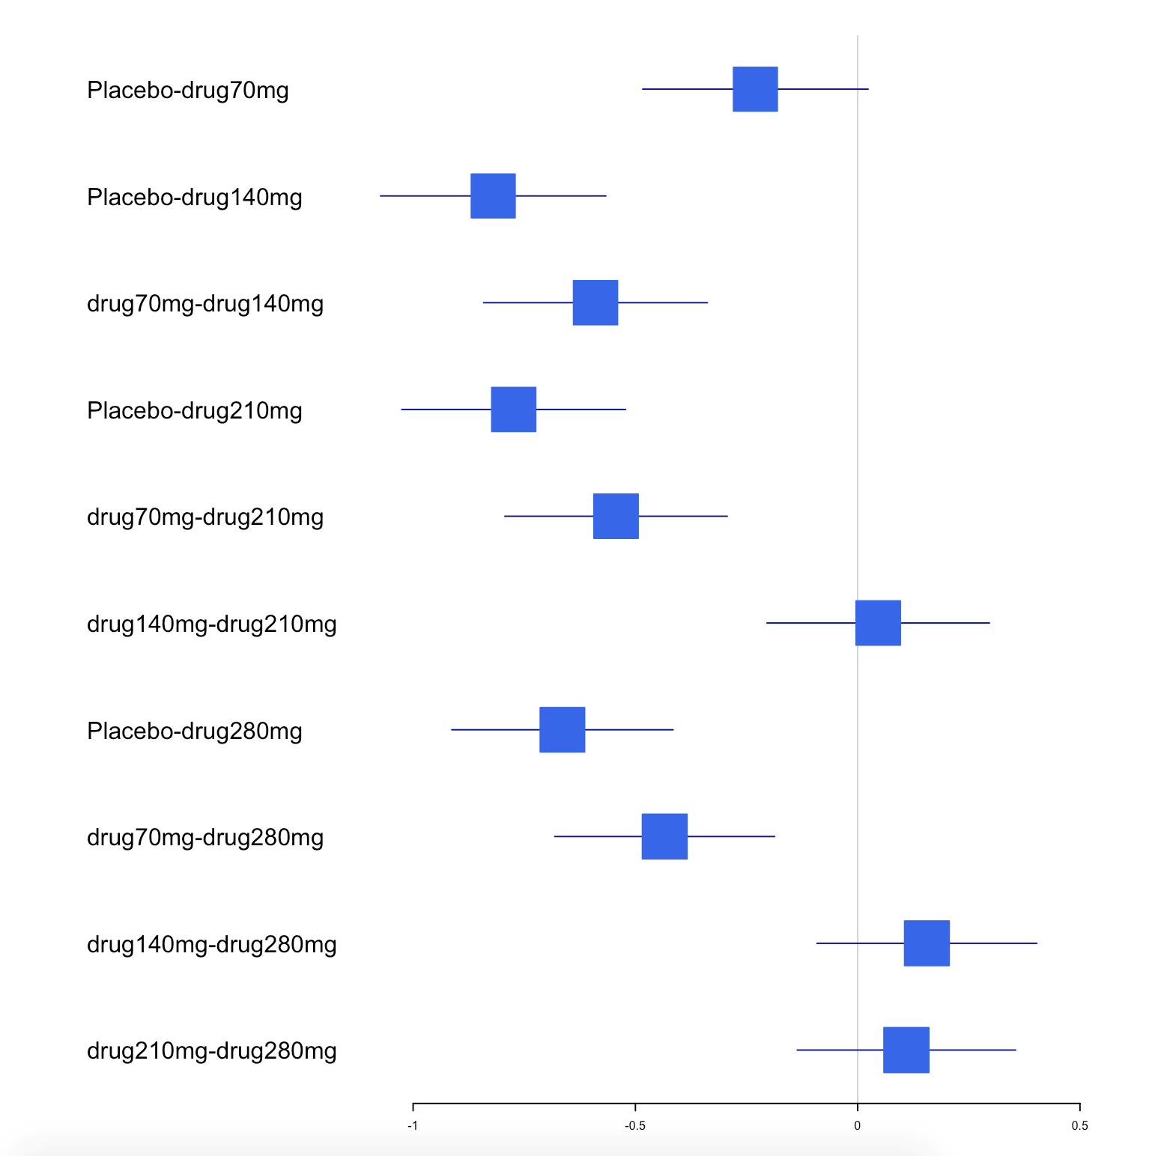
Question IV-b-pairwise comparison
For sPGA score:

Slide 25
Question IV-b-which dose should be chosen?
140mg or 210? Not 280mg definitely!

Slide 26
Question V
Key word: baseline characteristic, primary endpoint, secondary endpoint

Slide 27
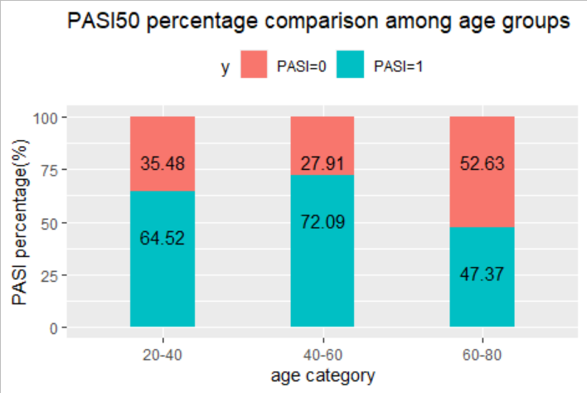
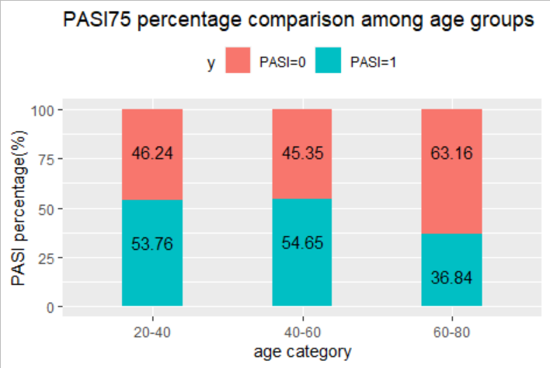
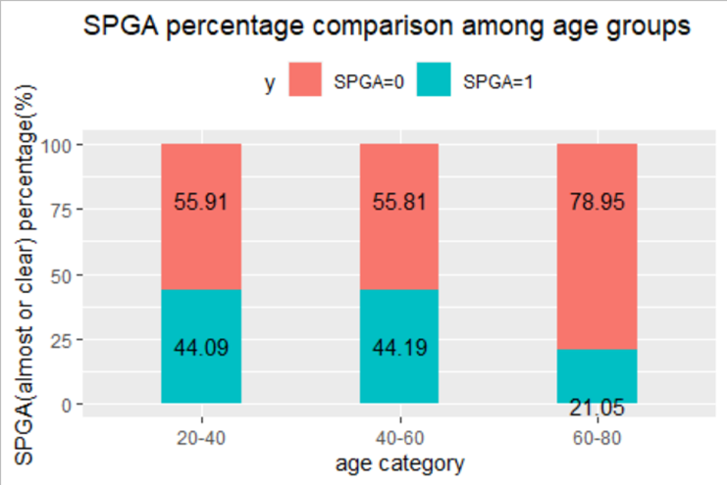
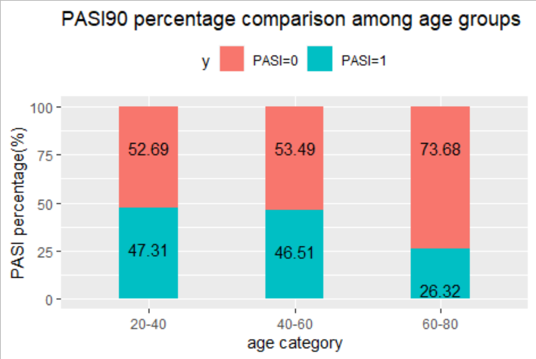
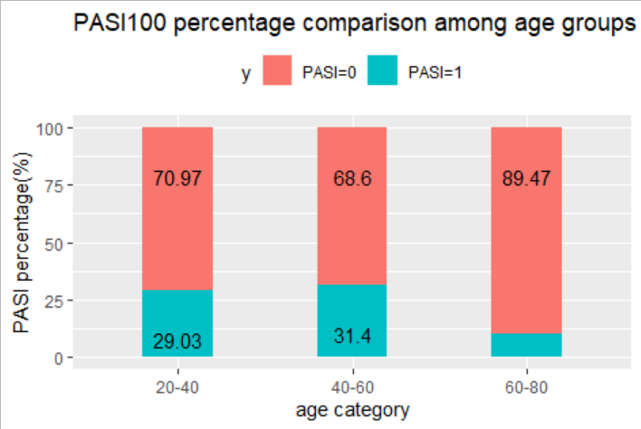
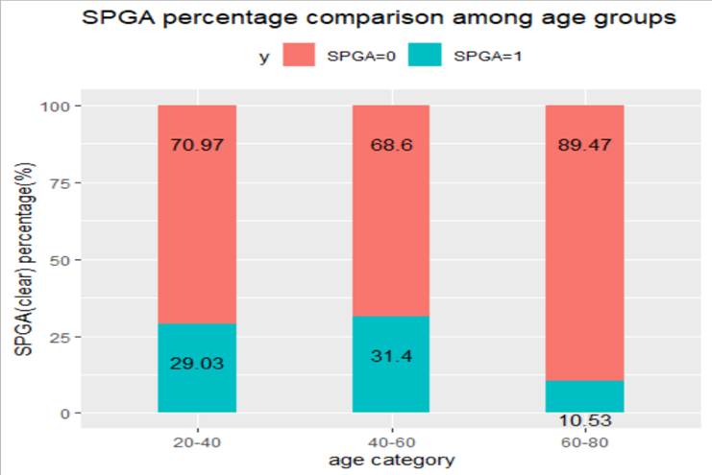
Question V-compare subgroup-age

Slide 28
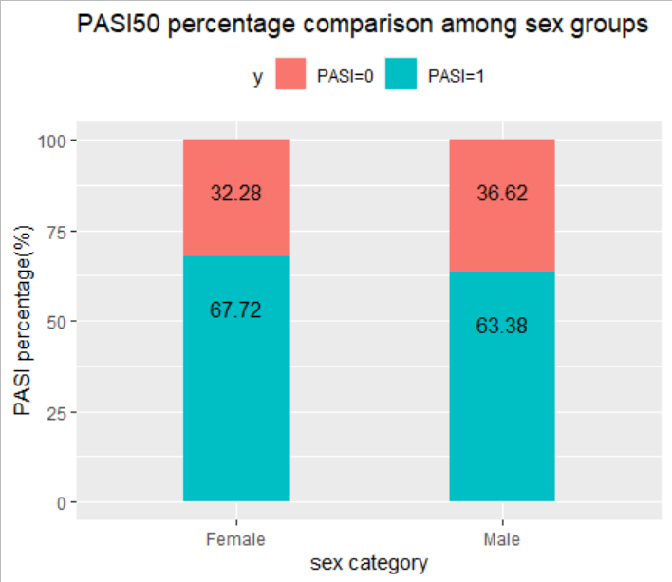
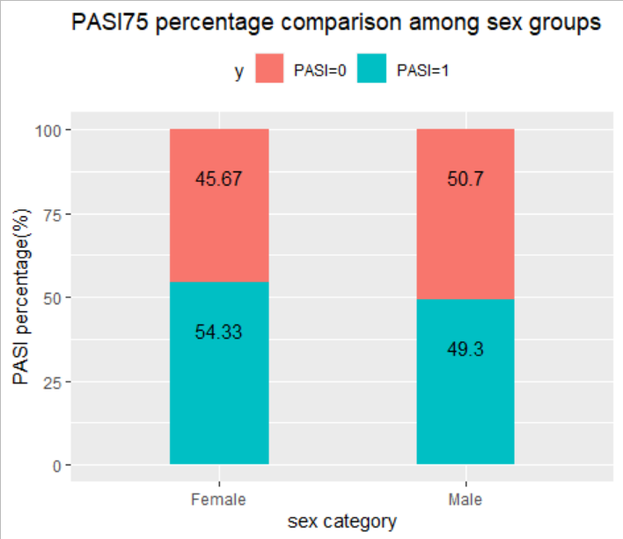
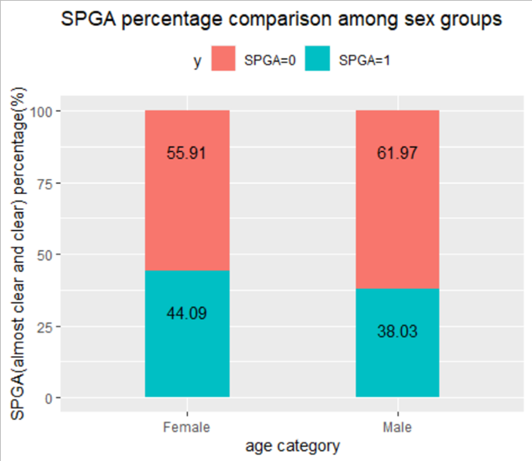
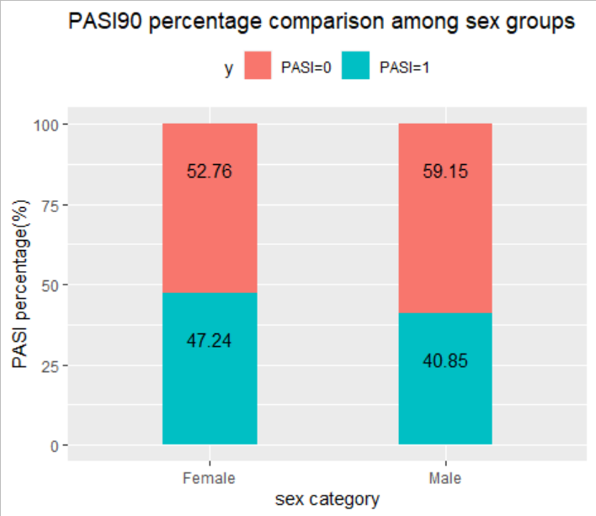
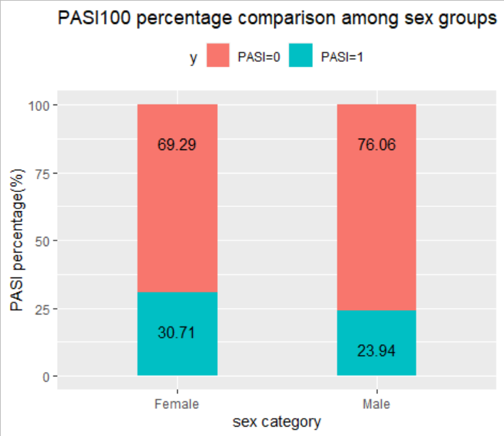
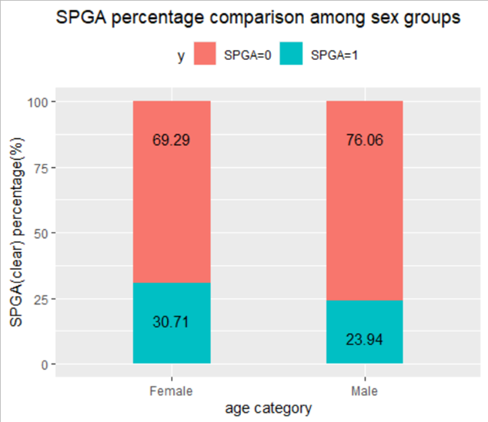
Question V-compare subgroup-sex

Slide 29
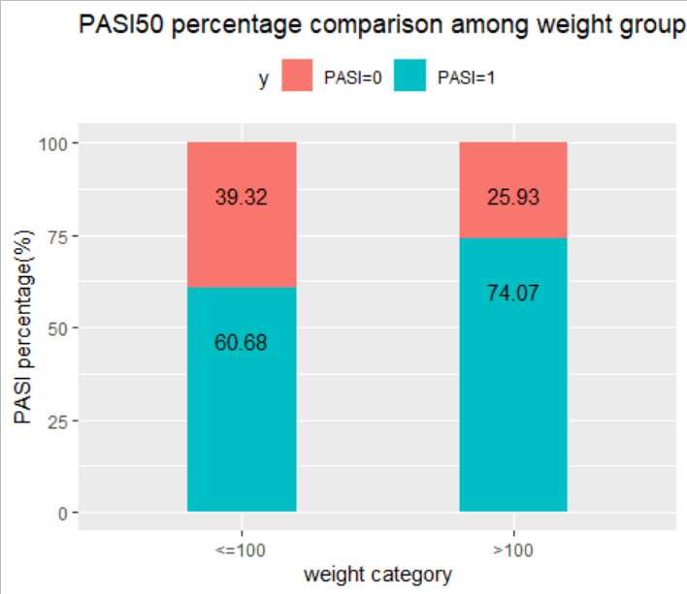
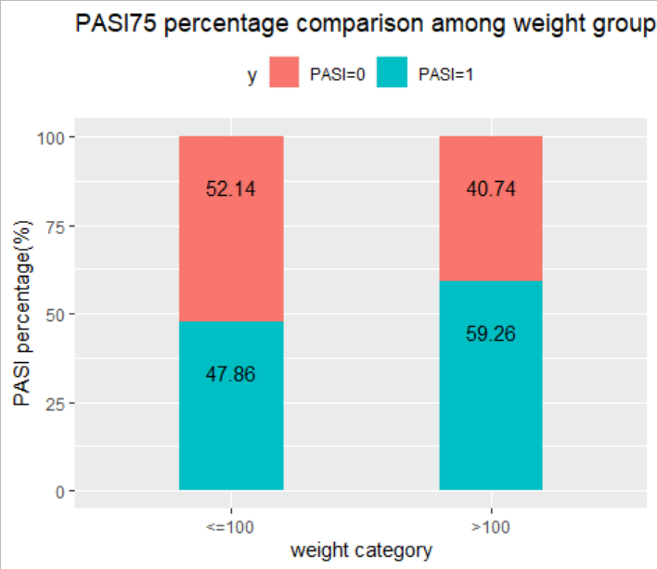
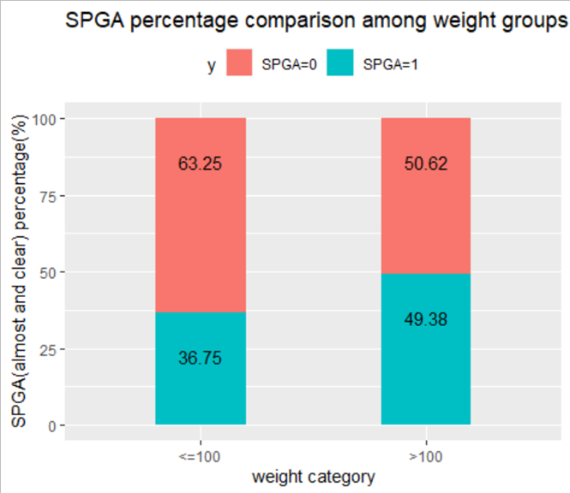



Question V-compare subgroup-weight

Slide 30


Question V-primary endpoint-ANCOVA
rationale
Adequacy

Slide 31


Question V-secondary endpoint-logistic
For PASI 50:
For PASI 75:

Slide 32


Question V-secondary endpoint-logistic
For PASI 90:
For PASI 100:

Slide 33


Question V-secondary endpoint-logistic
For sPGA (clear or almost clear):
For sPGA (clear):

Slide 34
Question V- age subgroup analysis at 140mg and 210mg dose
Which dose should be used in which age group of patients？
Can we find this certain dose?

Slide 35
Question VI

Slide 36

Question VI

Slide 37

Quesiton VII

Slide 38
Quesiton VII-AE summary
Table 7: Adverse events in phase 2
 | Test drug 70mg | Test drug 140mg | Test drug 210mg | Test drug 280mg
 | N=39 | N=39 | N=40 | N=42
Event | number of patients (%)
Any preferred term | 22 (56.4) | 26 (66.7) | 30 (75) | 33 (78.6)
-Mild | 15 (38.5) | 14 (35.9) | 14 (35) | 17 (40.5)
-Moderate | 6 (15.4) | 4 (10.3) | 11 (27.5) | 12 (28.6)
-Severe | 2 (5.1) | 8 (20.5) | 5 (12.5) | 4 (9.5)

Slide 39
Thank you!
Notes:
在“幻灯片放映”模式下，选择箭头访问相应链接。

